Slide 1


EENG385 - Electronic Devices and Circuits
Lab 07:
Audio Amplifier Analysis
Objective:
Study the design and of the audio board.
Create amplifier model
1

Slide 2
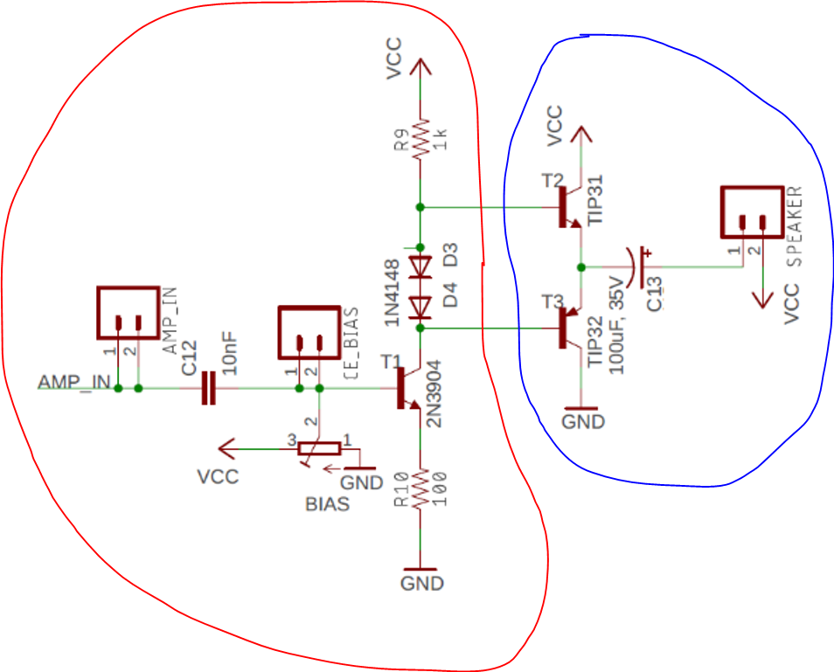
Overall structure
Two stage
Input from audio source via 3.5mm jack
Input stage if common emitter, voltage amplifier
Output stage is common collector, current amplifier.
2
2
Notes:
2

Slide 3
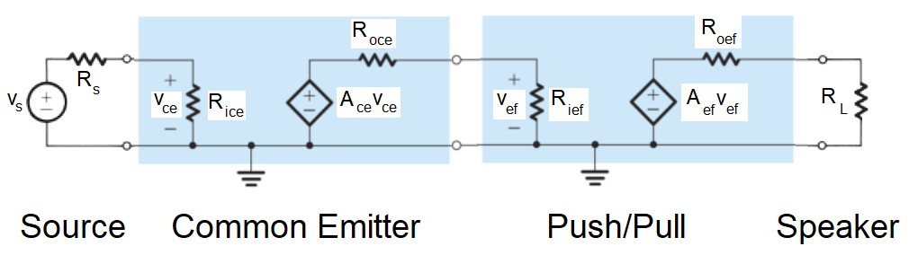
Mathematical Model
Source is your MP3 player
Use analysis to determine values
Lots of simple math
3
3
Notes:
3

Slide 4
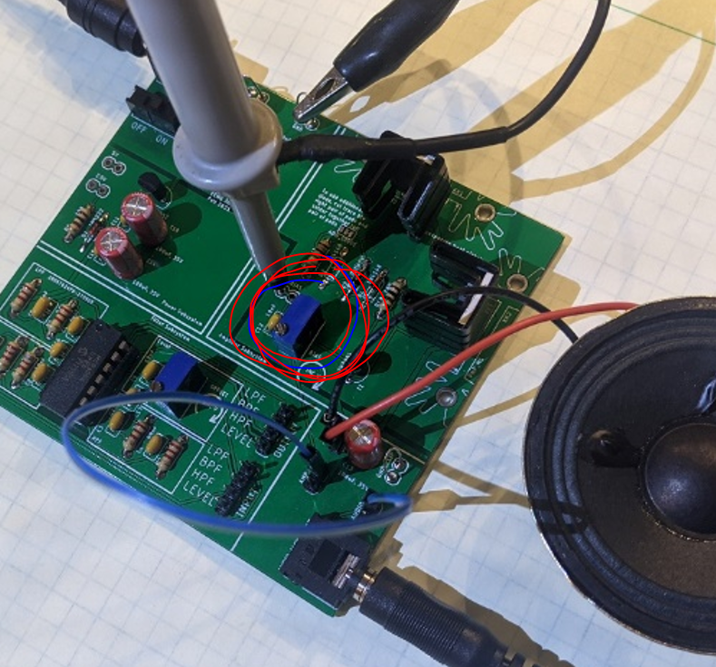
Working with Audio Amplifier
You will need
Speaker (don’t get to keep)
Audio cable (don’t get to keep)
Power at 9V with lab supply
Supply audio through cable
Install jumper wire
Audio input
Amplifier input
Adjust bias of POT
Circled in red
Watch for things getting hot
4
4
Notes:
4

Slide 5
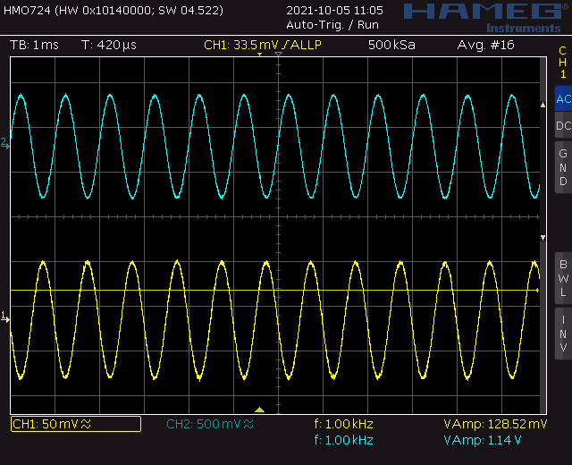
Measure performance
Measure no speaker
Voltage from MP3 player (yellow)
Collector of first stage BJT (blue)
Relative amplitudes are what matters
5
5
Notes:
5

Slide 6
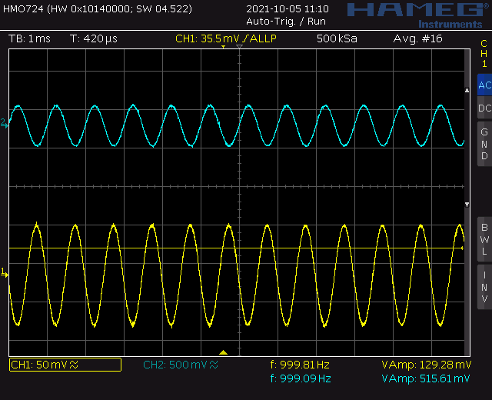
Measure performance
Measure with speaker
Voltage from MP3 player (yellow)
Collector of first stage BJT (blue)
Relative amplitudes are what matters
Different ratio
6
6
Notes:
6

Slide 7
Have fun
Components are safe up to 25V or so
Find a big speakers – give it a go!
Decrease emitter resistor for more gain
Things may get hot
I have heat sinks if needed
Use FLIR camera to keep an eye on things
Lick finger before touching suspect component
Sizzle = hot
Smell for melting components
7
7
Notes:
7

Slide 8


